Slide 1
Monitoring and Evaluation of VCT programs
Dr. Kate Ssamula Kitakule
Project coordinator- HIV Rapid testing project
AHF- Uganda Cares

Slide 2
Outline of the presentation
VCT, RCT, HCT definitions
Background and evolution of HIV testing
Common practices in diff. countries in Africa, couple testing. Share experiences.
Why VCT?
Logical framework for VCT
Important M&E questions for VCT programs
Indicators
VCT tools
Monitoring systems at different levels
Key aspects in the monitoring system
Key aspects in the evaluation system
References

Slide 3
Definitions
VCT: Voluntary HIV counseling and testing
Self-initiated HIV testing and prevention counseling
Often offered in free-standing sites, may be integrated into health centers, mobile units, and community-based settings
Rapid tests
HCT: HIV counseling and testing
RCT: Routine or “opt out” HIV counseling and testing
HBCT: Home-based counseling and testing
CHCT: Couple HIV counseling and testing

Slide 4
Background and evolution of HIV testing
Paradigm shift from client-initiated testing for personal reasons to provider-initiated testing for medical diagnosis
Proliferation of many models
Traditional VCT
Mobile VCT and outreach VCT
Door to door and home based testing
Testing in medical settings
New technologies allowing for great expansion
Rapid, on site tests using whole blood, urine, saliva

Slide 5
HIV Testing and counseling models
Community Based T&C
Traditional client-initiated VCT
Free-standing as well as in health facilities
Mobile
Door to door or home based T&C
Workplace and other special settings
Special events, campaigns, target groups
Provider-initiated T&C
Integrated into medical care
Home testing for family members of ART patients

Slide 6
Common practices in different countries in Africa
South Africa: Countrywide VCT campaign in 2010
Botswana
Uganda: Mass rapid testing
Workshops and special events
Mobile testing
Home testing for family members of ART patients
Self-testing: pilot project in South Africa
Moonlight testing

Slide 7
Couple counseling and testing
Years of experience in many countries
Counselor assisted mutual disclosure
Counseling based on results of both partners
Evidence for prevention effectiveness
Reduction in incidence in discordant couples
Estimate that 30% to 75% of heterosexual transmissions in Africa could be prevented
Need to expand to non-cohabiting couples

Slide 8
Why VCT?
Prevention
Early treatment and care
Behavior change and making better choices
Awareness of and knowledge about HIV
Linkages to other relevant services, such as sexually transmitted infection treatment, family planning, and prevention of mother-to-child transmission programs
Planning for the future

Slide 9
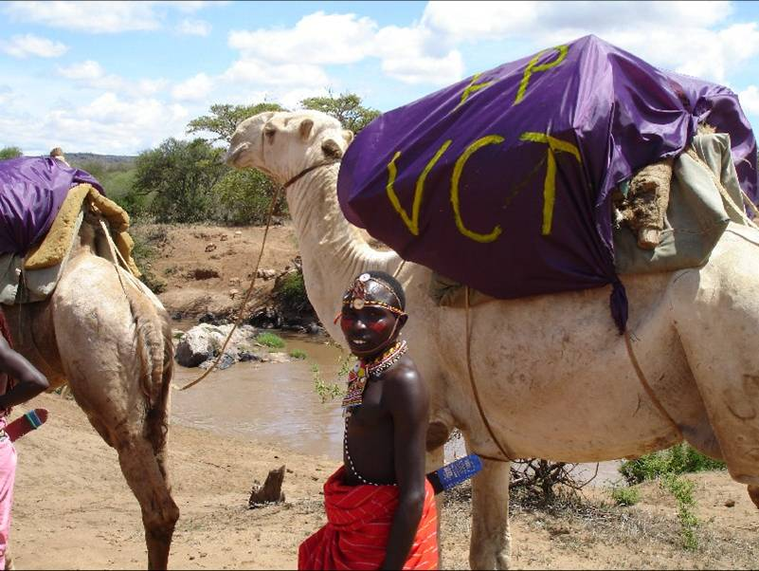
Camel VCT serving nomads in northern Kenya

Slide 10
A mobile van is used to provide HIV counseling and testing by Right to Care, a USAID-funded program in South Africa. Source: A. Surdo

Slide 11
Flow of HIV testing procedure
Identify areas that need to be monitored

Slide 12
Planning for monitoring and evaluation.
Situational analysis
What do we want to know? This includes looking at indicators for both internal issues and external issues.
Strengthen existing M&E plan.
Costs.
Different kinds of information needed.
How will we get information?
Who should be involved?
Information use and dissemination.

Slide 13
Logical framework for VCT
Input - Processes – Outputs – Outcome- Impact
Strategies | Testing activities | VCT centres | Behavior change | Disease burden
Policies | Purchasing | No trained |  | Incidence
Guidelines | Training | No. counseled and tested |  | prevalence
financing | VCT campaigns
Human resource | Quality assurance
Logistics | Quality control

Slide 14
Important M&E questions for VCT programs
Are VCT services reaching the target population?
Is there a reduction in HIV prevalence?
Do the services provided adhere to minimum quality standards?
Are VCT services being provided as outlined in the project plan?

Slide 15
6 questions for a good M&E system
What do you want to measure? | E.G Increased VCT uptake at community level
Why? | Rationale: main intervention being proposed
How? | Methodology to be used
Where? | Different levels of the health system, community, NGOs
When? | Timing- daily, weekly, monthly, quarterly
Who? | People responsible

Slide 16
INDICATORS
Pregnant women counseled and tested for HIV
Number of clients who visit a VCT centre
% of clients who agreed to be tested for HIV
% of clients who tested for HIV and received their results
% of clients who were referred for other services
Number of couple counseling sessions conducted
% number of clients who tested positive for HIV

Slide 17
Data sources
Clinical records
Patient register
Laboratory records
HMIS
Referral records
Store records
Others
Surveys
Surveillance data
Qualitative research

Slide 18
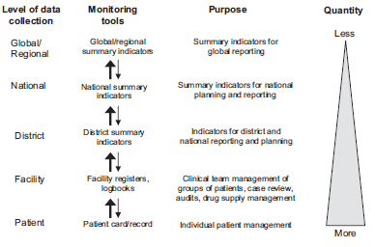
Monitoring systems at different levels
Source: World Health Organization (WHO). Patient monitoring guidelines for HIV care and antiretroviral therapy (ART) Geneva. WHO, 2006.

Slide 19
Key aspects in the monitoring system
Monitoring is an internal function of any project or organization.
Establishing indicators of efficiency, effectiveness and impact;
Setting up systems to collect information relating to these indicators;
Collecting and recording the information;
Analyzing the information;
Using the information to inform day-to-day management

Slide 20
Key aspects in the evaluation system
Did the project or organization achieve what it was intended to achieve;
what difference did it want to make?
What impact did it want to make?
Assess progress towards impact targets.
Looking at the strategy of the project or organization.
Did it have a strategy?
Was it effective in following its strategy?
Did the strategy work? If not, why not?
Looking at how it worked.
Was there an efficient use of resources?
What were the opportunity costs of the way it chose to work?

Slide 21
Key aspects in the evaluation system cont.
How sustainable is the way in which the project or organization works?
What are the implications for the various stakeholders in the way the organization works?

Slide 22
Implications of M&E
Stronger M&E systems will lead Programs improvement and better services for beneficiaries
Coverage and quality
Example - Refocusing of interventions (Testing) will yield data that enables appropriate targeting of prevention services
Global and In-country indicator harmonization
Operations research
Dissemination and adoption of best or promising practices

Slide 23
Challenges
Limitations to interpreting HIV prevalence trends
Support supervision
Data quality
Limited capacity for M&E at different levels
Getting information on activities conducted outside the health sector
Lack of political commitment

Slide 24
References
Handbook of Indicators for HIV/AIDS/STI Programs. 1st Edition. March 2000
http://www.avert.org/aids-uganda.htm visited on 3/03/2011.
http://www.usaid.gov/our_work/global_health/aids/TechAreas/prevention/counseling_testing.pdf
Richter. M, Venter. W. D. F, Gray. A. Home self-testing for HIV: AIDS exceptionalism gone wrong. SAMJ, October 2010; 100: 10 (636)
World Health Organization (WHO). Patient monitoring guidelines for HIV care and antiretroviral therapy (ART) Geneva. WHO, 2006.
National monitoring and evaluation plan for voluntary HIV counseling and testing.

Slide 25
The End.

